Slide 1
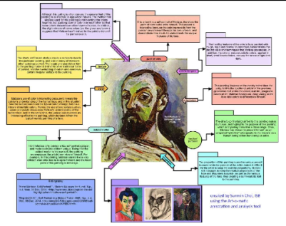
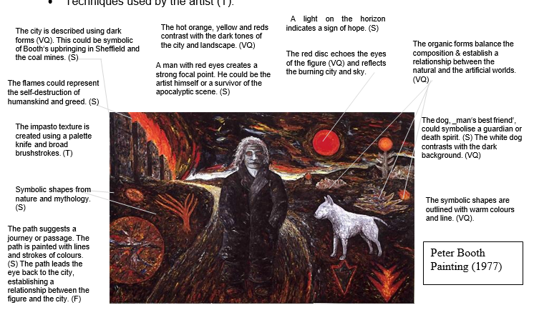
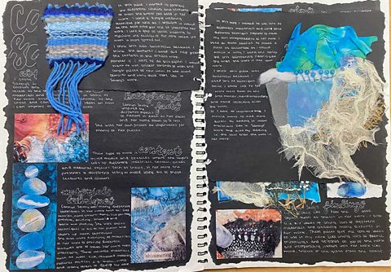
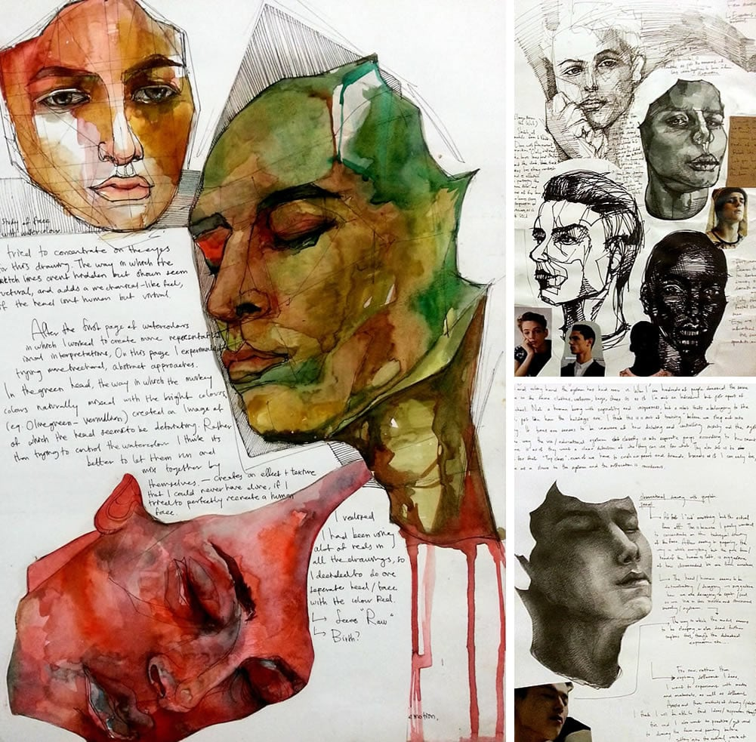
Weekly Checkpoint: Mentor Artist & Experiment Annotation
Over the next 3 weeks, you will complete:
🔹 One annotated mentor artist per week
Include an image of one artwork
Annotate how this artist connects to your inquiry question and focus
Explain what you’ve learned and how it’s influenced your own ideas
🔹 One annotated experiment per week
Include images of your practical experiment
Annotate what worked, what didn’t, and how it’s helping you move forward
Reflect on whether it’s shaping your ideas, materials, or concepts
These annotations will help track your progress and give you clear direction toward your final artwork.

Slide 2
What to include:
A clear image of one artwork by your mentor artist
Annotate the image with:
What materials and techniques they used
What ideas or messages they are exploring
How the work is alternate (e.g. in materials, meaning, display, or audience interaction)
Why you chose this artist – how do they relate to your inquiry question and focus statement?
Use dot points – keep it clear and focused.
These instructions are a reference DELETE once you’ve completed the slide

Slide 3
What to include:
Several clear photos of your experiments
Any reference images, media tests, or materials you’ve explored
Annotate each image with:
What were you trying to do?
What worked well?
What didn’t work?
Will you continue this idea or change direction? Why?
These instructions are a reference DELETE once you’ve completed the slide

Slide 4
Respond to these questions!
Reflect and plan:
What will you do next with your ideas and materials?
What do you need to test, collect, or improve?
How will you push your ideas further – both technically and conceptually?
Think:
How does this work fit into Art as Alternate?
Are you using unusual materials or display?
Are you exploring bold or challenging themes?
Are you trying to get the viewer to think or respond in a new way?
Make clear connections:
What have you borrowed or adapted from your mentor artist?
How has their work helped shape your own ideas or experiments?
How does your work reflect your inquiry question and focus statement?

